Slide 1
Data Science
Learners Group

Slide 2
What is Data Science?
Assumptions:
Most data is the result of a statistical process.
Inherent noise
Melding of statistics, programming, and mathematics.
Identify business problems
Find applicable data
Come up with applicable solution
What Data Science is not:
Machine Learning
Machine learning is a toolset.
AI

Slide 3

CRISP – DM Framework
Standard data science project workflow.
Very iterative

Slide 4
Business Understanding
What are the project objectives?
How to integrate?
Possible outcomes, good and bad.
Criteria for project success?
Conversion to a data science type problem.

Slide 5
Data Understanding
Data collection:
Contacting different teams.
Understanding what is available / needed.
Exploratory Data Analysis
Quality of data (from a prediction standpoint)
Redundancies?

Slide 6
Data Preparation
Creating base analytics table.
Create unique fields, tease out more information.
Creating dummy variables (as needed)

Slide 7
Modelling
Grid-searching model types and parameters.
Re-tuning models.
Testing models against each-other.

Slide 8
Evaluation
Understanding impact (ROC and scoring)
Accomplish goals set in step 1?

Slide 9
Deployment
Automate model
Application
Single report
Part of Business Understanding

Slide 10
Use Cases
Supervised Learning:
Specific target we want to predict.
Vast majority of cases.
Unsupervised Learning:
No specific target.
Data Understanding
Special Topics:
Also Data Understanding
Data Acquisition
Automation

Slide 11
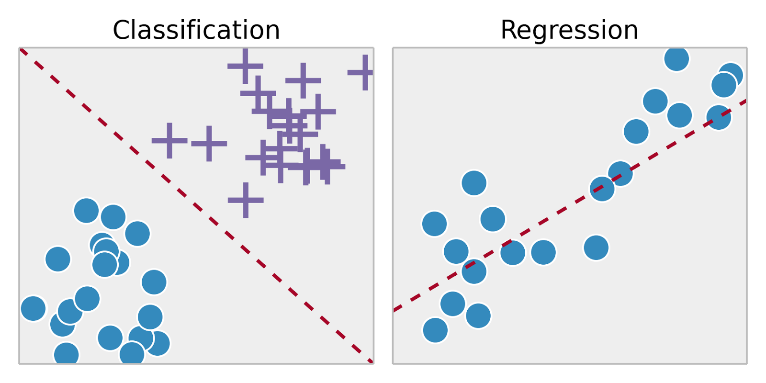
Supervised Learning
Target that we want to predict:
When should we expect?
How much should we expect?
Examples:
Regression Models
Classification models
Time Series

Slide 12
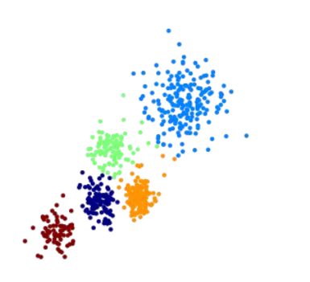
Unsupervised Learning
No Specific Target
Find similar groups of…
What else would you like?
Examples:
Recommender Systems
Clustering
Natural Language Topic Modelling

Slide 13
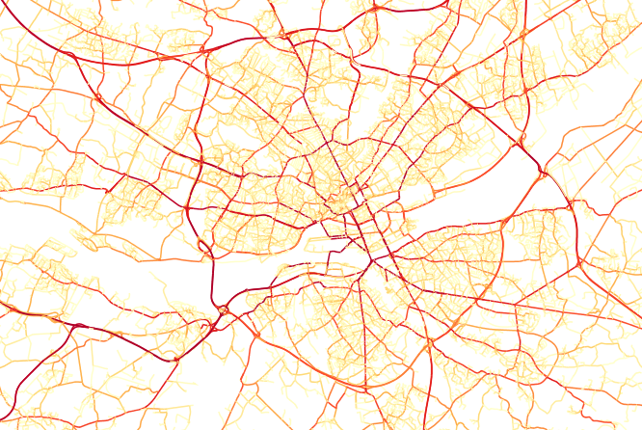
Special Topics
Natural Language Processing (NLP)
Web Scraping
Graph Theory
Automation

Slide 14
Short Case Study

Slide 15
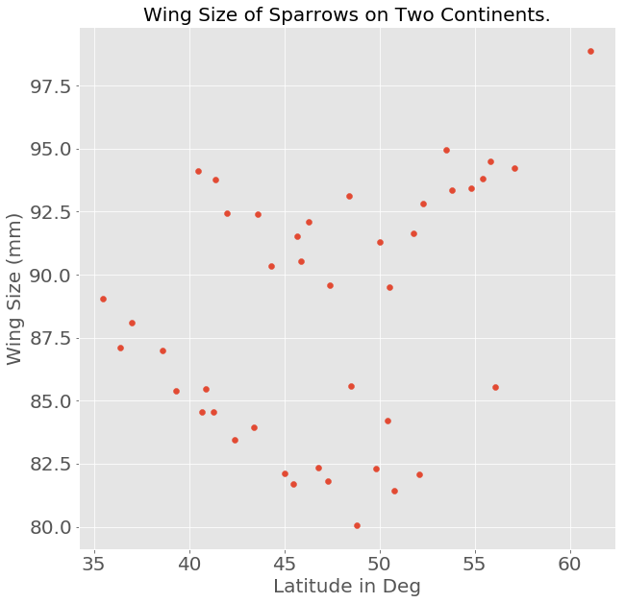
What Random Process created this data?

Slide 16
Business Understanding
Want to determine wing size based off location of bird spotting.

Slide 17
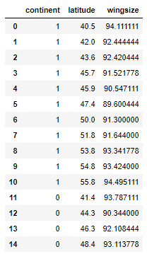
Data Understanding
What data is available to us?
Do we need to collect more data to achieve our goal?

Slide 18
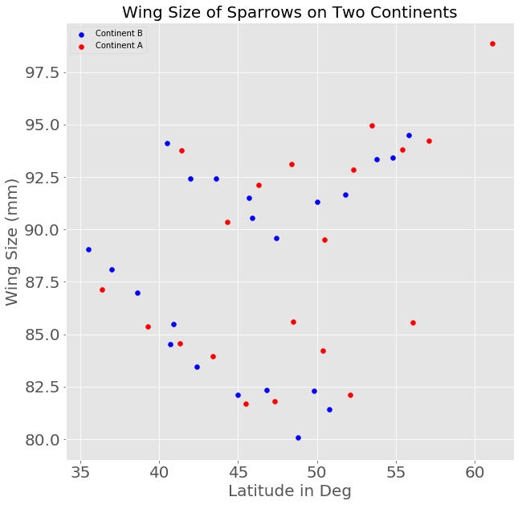
Data Understanding
What data is available to us?
Do we need to collect more data to achieve our goal?
How informative are the features? (Columns)

Slide 19
Data Preparation
Already seems pretty prepared.

Slide 20
Modelling
Utilize business logic to decide on how you want to optimize the model.
Try many models and parameters (grid-search).

Slide 21
Modelling
Utilize business logic to decide on how you want to optimize the model.
Try many models and parameters (grid-search).
RMSE

Slide 22
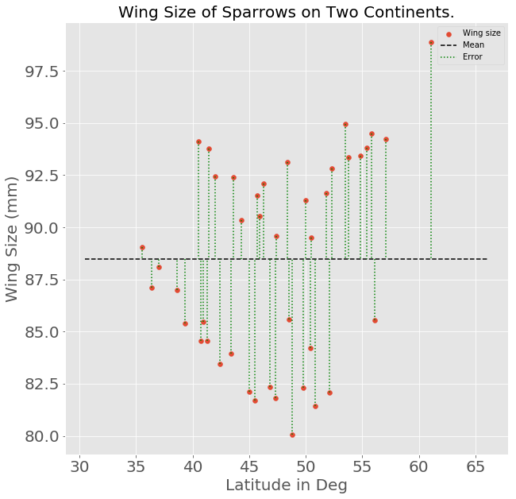
Modelling Regression:
0th Degree Polynomial
Mean Fit

Slide 23
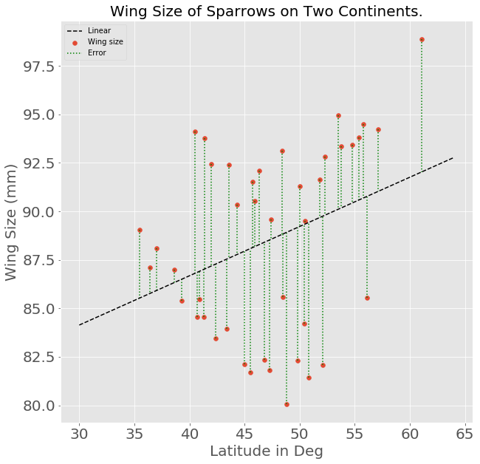
Modelling Regression:
1st Degree Polynomial
Linear Fit

Slide 24
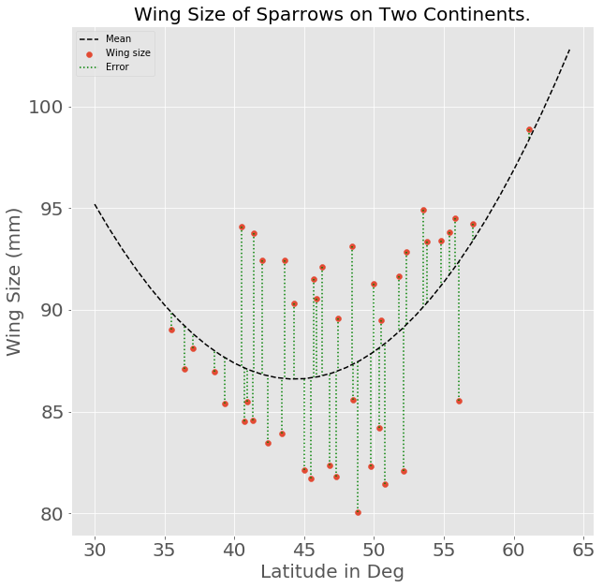
Modelling Regression:
2nd Degree Polynomial
Quadratic Fit

Slide 25

Evaluation
Did we do a good job?
Is there more informative data?

Slide 26
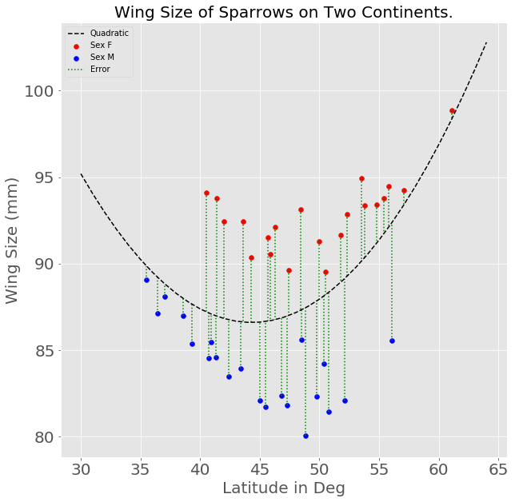
Evaluation → Data Understanding / Acquisition
What if we discover that we had gender of the birds?

Slide 27
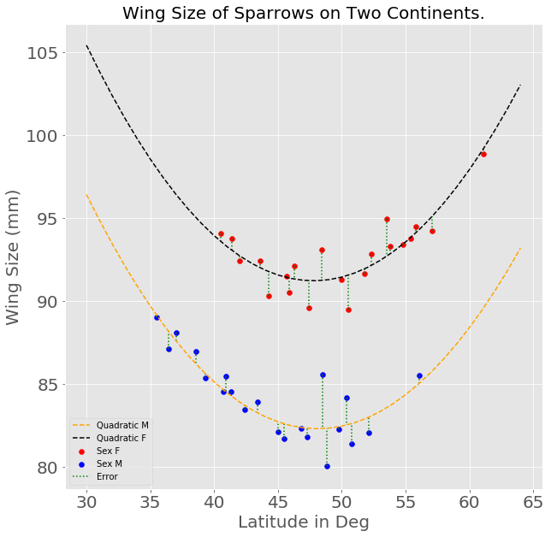
Evaluation → Data Understanding / Acquisition
What if we discover data for gender of the birds?
And we built two models?

Slide 28
Deployment
Build an web application
Integrate to existing systems
Whatever the business needs

Slide 29
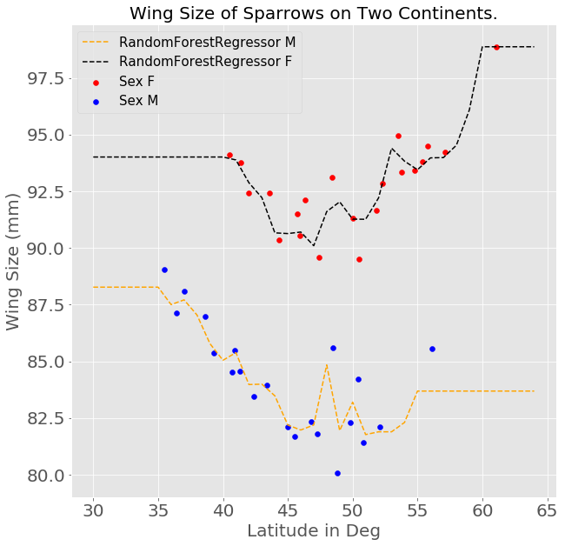
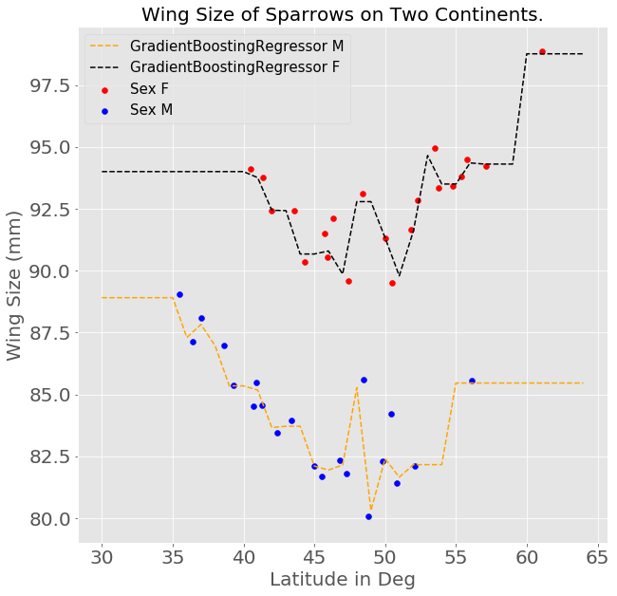
Other Model Types

